Slide 1
Code compliance city of Sarasota 1565 1st street, annex bldg 2nd floor Sarasota, fl 34236
Joshua Spence
Coordinator of Code Compliance
(941)263-6538
Joshua.spence@sarasotafl.gov
Notes:
Thanks!
Diane Kennedy, Code Compliance Manager
November of 2015
Background:
Sarasota Co – 8 years
Title insurance & mtg. – 7 years
Paralegal – 5 years

Slide 2
Let’s talk!!
What is Code Compliance?
What is our goal and mission?
What are the most common violations?
What happens to your complaint?
What is the informal inspection process?
How do we communicate with citizens?
What do I do if I receive a warning door hanger?
How do I submit a complaint?
Questions?
Notes:
Read the bullet points.

Slide 3
What is code compliance?
What is Code Compliance?
Enforce codes
City Code
Zoning Code
Florida Building Code
Standard Housing Code
Commercial Business and Industrial Building Minimum Standards
Standard Unsafe Building Abatement Code
Engage with our community
Educate our citizens
Florida Statute Chapter 162
Notes:
The enforcement of local codes and ordinances which are enacted by your City Commission.
Code compliance is vital to keeping our city clean, safe, and beautiful.
City and Zoning – written by and at the direction of your city commissioners
TALK TO YOUR COMMISSIONERS ABOUT CHANGES YOU’D LIKE TO SEE!
Florida Building Code – 2020 – unpermitted work and expired permits.
Standard Housing Code – maintenance and upkeep of the exterior and interior of residences.
Commercial Business & Industrial – maintenance and upkeep of our commercial buildings.
Engage – attending community meetings i.e. CCNA and doing presentations
Educate – toolbox – the most important tool
Florida Statute 162 – talk about recent changes to our city code

Slide 4
What is our goal and mission?
Code Compliance Goal:
Our goal is to gain voluntary compliance.
Code Compliance Mission:
To protect the health, safety, and general welfare of the citizens by enforcing building, zoning, housing, and other city codes.
Work with other departments
Educate citizens
Facilitate services between citizens and local agencies
Notes:
GOAL: FACE teaches voluntary compliance
Mission: Read mission
Work with other depts – SPD, PW, Parks & Rec, etc.
Educate – our most important tool and engage with citizens.
SWEEPS!
Facilitate services – HOT Team, Salvation Army, Senior Friendship Ctr, OHCD

Slide 5
What are the most common violations?
Overgrowth
Junk, Rubbish, Trash & Abandoned Articles
Recreational Vehicle Storage
Inoperable and/or Unlicensed Vehicles
Notes:
Overgrowth – 16-49 - 10” on developed lot & 12” on undeveloped lot.
JTR – 16-47
Recreational Vehicle Storage – VII-216
JVs – 16-50

Slide 6
What happens to your complaint?
Notes:
Walk through the diagram

Slide 7
Informal Inspection process
We can only address what we can see from the street right of way as well as to and from the front door.
We must have clear evidence of the violation that can be presented to the Special Magistrate if needed.
No peeking in windows, over fencing, or wandering on the property.
We are required to provide adequate time to correct the violation(s); except for repeat violations.

Slide 8
How do we communicate with citizens in our community?
Methods of Communication:
In person, by phone, and by email
HOA and community presentations
Leaving informational door hangers and literature
Notes:
Person – in the neighborhoods or in the office
Phone –
Email –
HOA & Community Presentations
Informational door hangers & literature
We always want to make contact with our citizens when there is a problem.
When we don’t get any response – initiate our code compliance process.
Talk about violation process. Refer to the “Warning” doorhanger.

Slide 9
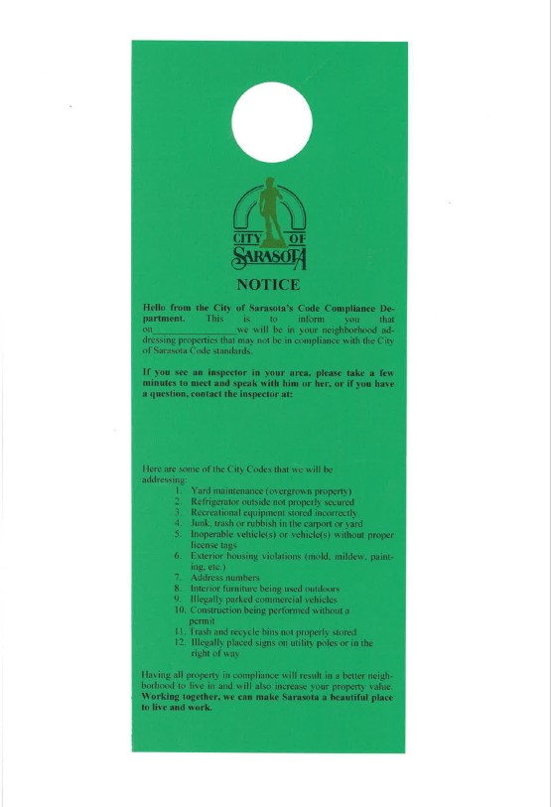
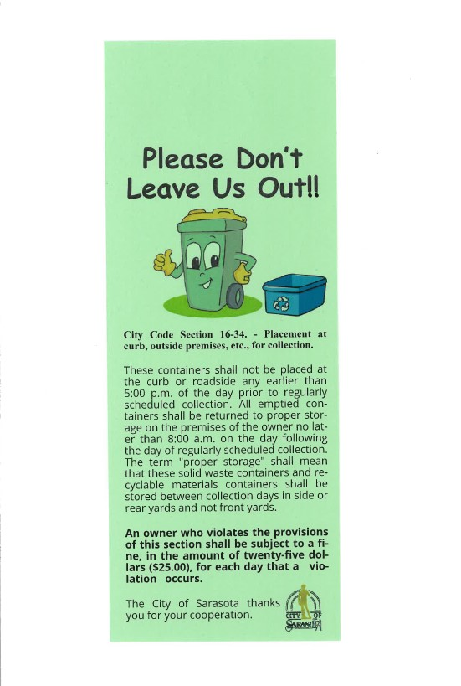
Neighborhood Sweep
Trash & Recycling Container Info
Notes:
Neighborhood Sweep – explain process
Trash & Recycle containers - explain

Slide 10
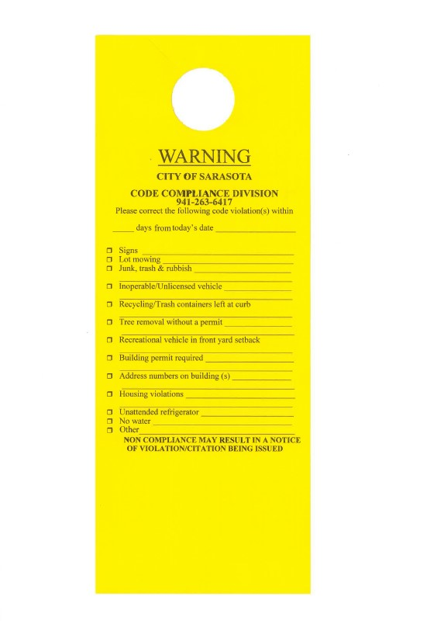
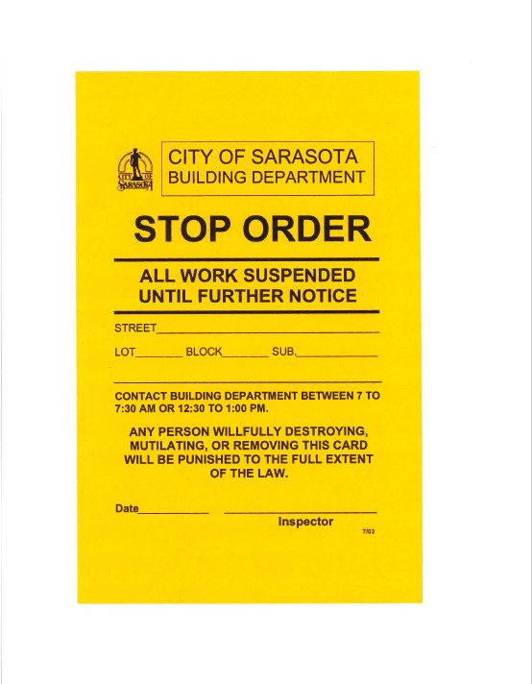
Initial Warning
Unpermitted Work
Notes:
Initial Warning – Talk about process
Stop Order – Unpermitted work – talk about process
Plumbing
Electrical
Structural
Mechanical
Over $1000
Illegal tree removal

Slide 11
What do I do if I receive a warning door hanger?
What is the violation?
When is the warning dated?
How many days do I have to correct?
Can I correct within the time given?
Do I need more time?
Do I need more information?
Call your inspector!!!
Notes:
Walk through each step!

Slide 12
How do I submit a complaint online?
www.sarasotafl.gov
Notes:
Submitting a complaint on-line

Slide 13
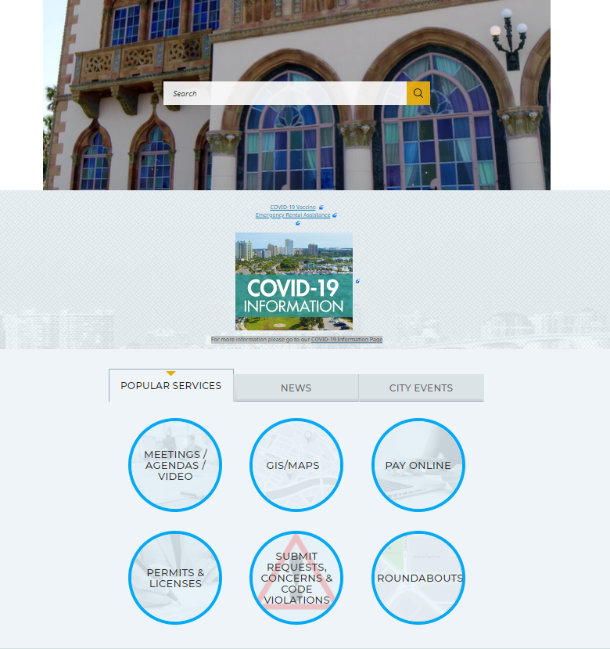
Scroll to the bottom
Scroll to the bottom
Notes:
Talk about each step of the process.

Slide 14
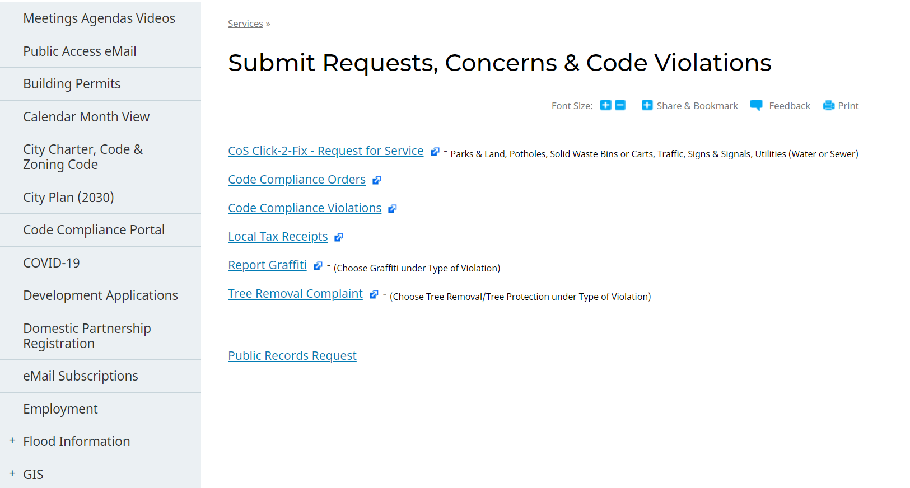
Notes:
Talk about each selection on this screen.

Slide 15
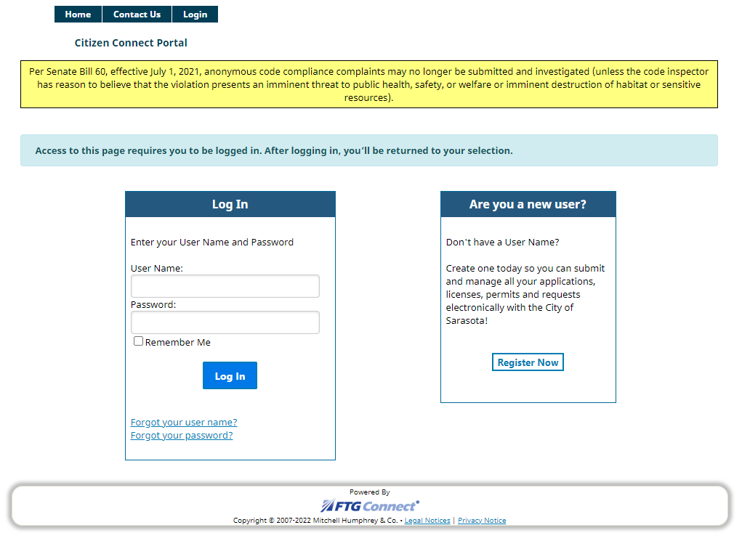
WHAT IS SENATE BILL 60 AND HOW DOES IT AFFECT YOU?
Anonymous complaints are prohibited unless it is deemed an imminent threat to public health, safety, or welfare.
Registration is required for website
Full name and address required
Public record laws
Notes:
Logging in and anonymous complaints.
Talk about Senate Bill 60

Slide 16
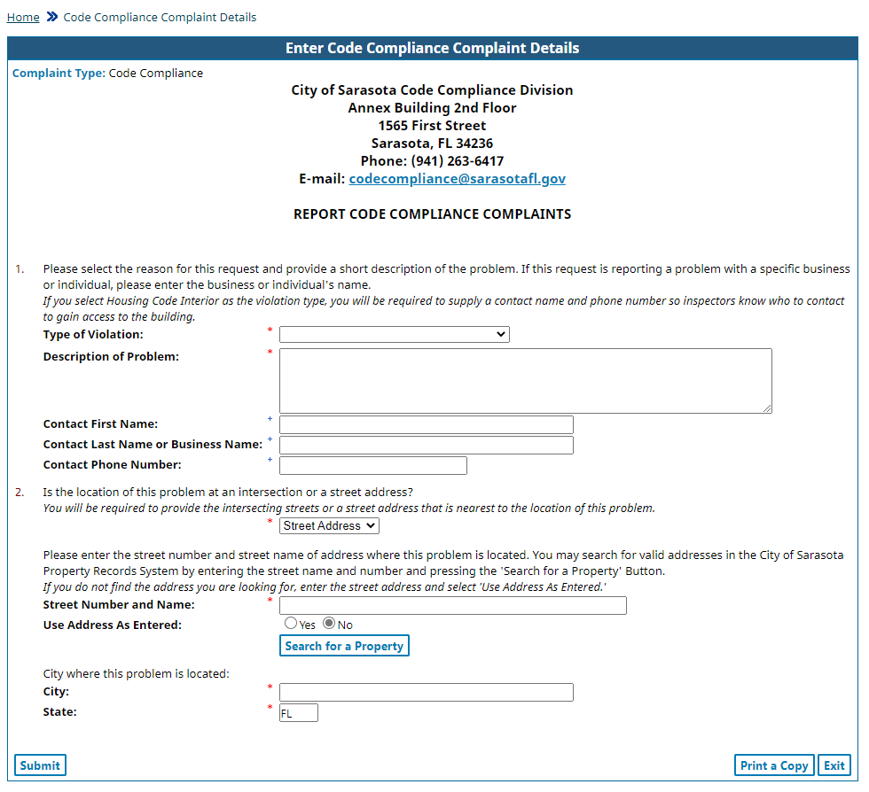
Fill in all blanks with red asterisks
Type in the house number and street name (do not include st, ave, pl, etc.)
Click “Search for a Property”
You may enter intersections
Click “Submit”
Notes:
Talk about each step and the required fields.

Slide 17
what if I’m not comfortable using the citizen connect portal?
Call us at 941-263-6417
Mail us at:
Code Compliance
1565 1st Street, Annex Bldg
2nd Floor
Sarasota, FL 34236
Email us at:
codecompliance@sarasotafl.gov
Notes:
Talk about each method:
Be sure to include your full name and address for the record.

Slide 18
Questions?

